Slide 1
FEM2401 Malaysian Politics & Society TOPIC 8: EXECUTIVE
Lecturer:
MUHAMMAD AMIR BIN MUNSHI

Slide 2
CONTENT:
The function of executive
Structure of executive branch
Prime Minister
The role Prime Minister
Cabinet
Member of Cabinet
Shadow Cabinet
Ministry and Public Services
Statutory Bodies
LEARNING OUTCOME:
To understand the concept of separation of power
To explain the function and structure of executive branch in Malaysia.
To know the role of Prime Minister and Cabinet

Slide 3
WHAT IS THE STRUCTURE OF A GOVERNMENT ADMINISTRATION?
Three governmental bodies: executive, legislative and judiciary
(It covers the in the topic 8 & 9)
The organisations involved in the country’s administration
The organisations that managing the country

Slide 4
THE CONCEPT OF SEPARATION OF POWER
The term "separation of powers" or "trias politica" was popularised by Montesquieu (Charles-Louis de Secondat, baron de La Brède et de Montesquieu), in 18th century by a French social and political philosopher.
It refers to the division of government responsibilities or administration power into three branches called; executive, legislative and judiciary.
All three branches of government must be supreme with their respective areas of jurisdiction.
The practice is different between presidential and parliamentary system (fusion power)
Each branch cannot interfere the function of others

Slide 5
The purpose is to
to limit any one branch from exercising the core functions of another.
prevent the concentration of power
provide for a mechanism for checks and balances – to ensure the three powers interact in an equitable and balanced way.
The administration power is divided into three branches of government bodies = the doctrine of separation of power.
ADMINISTRATION POWER:
Executive: power to carry out/execute law
Legislative: power to enact/make law
Judiciary: power to evaluate/interpret law

Slide 6
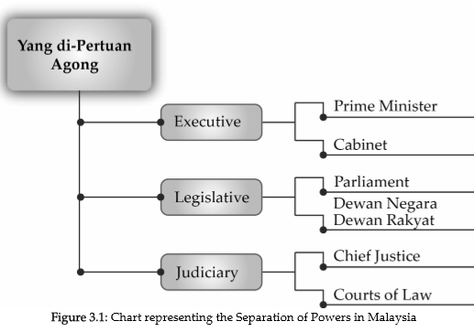

Slide 7
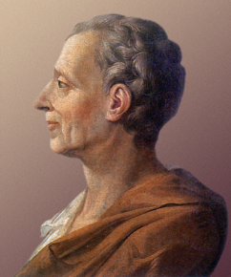
Montesqiue & Separation of Power
1748: published his major work: The Spirit of Law
In a nation, the forms of administration must be separate or in other words power must be segregated to avoid domination by certain quarters
“ when legislative power is united with executive power in a single person… there is no liberty, because one can fear that the same monarch that makes tyrannical laws will execute them tyraninically”.
Power tends to corrupt, and absolute power corrupts absolutely -Lord Acton

Slide 8
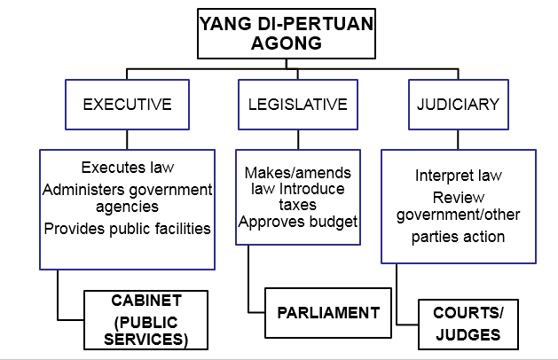
SEPARATION OF POWER
SEPARATION OF POWER IN MALAYSIA
Executive
Cabinet (US, UK, Malaysia)
Minister is the member of the cabinet
Legislative
Parliament (UK, Malaysia, Thailand)
Congress (US)
Judiciary
The court system – the highest court – higher system
The Federal Court (Malaysia)
The Supreme Court (US)

Slide 9
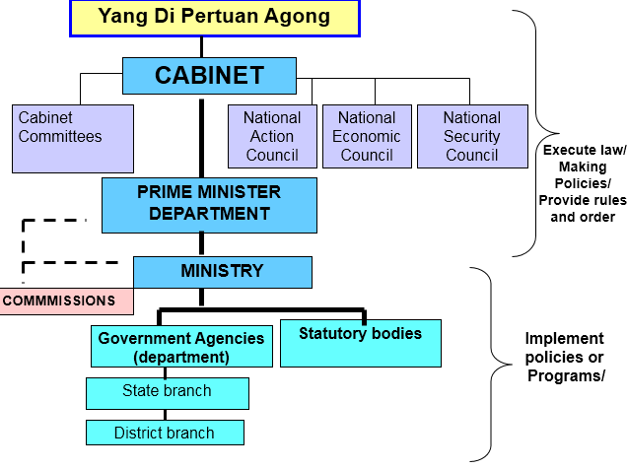
EXECUTIVE/ADMINISTRATION
In charge the execution of law, policies and general rules
Prime Minister, Ministers and Bureaucracy
Responsibility:
To ensure safety and peace of the country and smooth administration
To provide public and social facilities
To ensures justice
To brings about change towards national development (through financial management)

Slide 10
EXECUTIVE IN MALAYSIA
Execute law/Making policies
Yang di-Pertuan Agong
Highest authority
Cabinet
Ministers
Highest government agency responsible to execute laws/make government policy
Prime Minister
Head of cabinet

Slide 11
MALAYSIAN CABINET
Comprises of members who are appointed full ministerial status (a Minister)
Formally, the Yang di-Pertuan Agong appoints all Ministers on the advice of the Prime Minister
Function – to advice the King in governance
Each member have a collective responsibility to the Parliament
Prime Minister – Chairman of the Cabinet
(Article 43 of the Constitution), members of the Cabinet can only be selected from members of either houses of Parliament.
FUNCTIONS:
To implement the executive authority of the YDPA
To design and make the main public policies of the nation
To assist the federal government in standardizing the administration system
List of Cabinet Members:
https://www.kabinet.gov.my/bkpp/index.php/anggota-pentadbiran/menteri

Slide 12
CABINET MEMBERS/MINISTERS
30 ministries with 31 Ministers
Head by Prime Minister
Functions:
To implement the executive authority of the YDPA
To advice The King in governance
To design/make the main policies of the country
Collectively responsibility to the Parliament
Decision made by the Cabinet have to be agreed by all members
Cabinet members are bound to the decision made.

Slide 13
Other important political positions (related but not directly a member of Cabinet) – appointed by YDPA
Appointment from either houses of Parliament
Deputy minister – assist the Minister
Parliamentary Secretaries – assist both Minister and Deputy Minister
Political Secretaries – not among the member of the Parliament –recommendation and appointment by PM– serves to Minister

Slide 14
PREVIOUS PRIME MINISTERS OF MALAYSIA
1. Tunku Abdul Rahman (1963-1970)
2. Abdul Razak Hussein (1970-1976)
3. Hussein Onn (1976-1981)
4. Mahathir bin Mohamad (1981-2003)
5. Abdullah Ahmad Badawi (2003-2009)
6. Najib Razak (2009-2018)
7. Mahathir bin Mohamad (2018-2020)
8. Muhyiddin Yassin (2020-2021)
9. Ismail Sabri Yaakob (2021-2022)
WHO IS THE CURRENT PRIME MINISTER? WHAT IS HIS NAME?

Slide 15
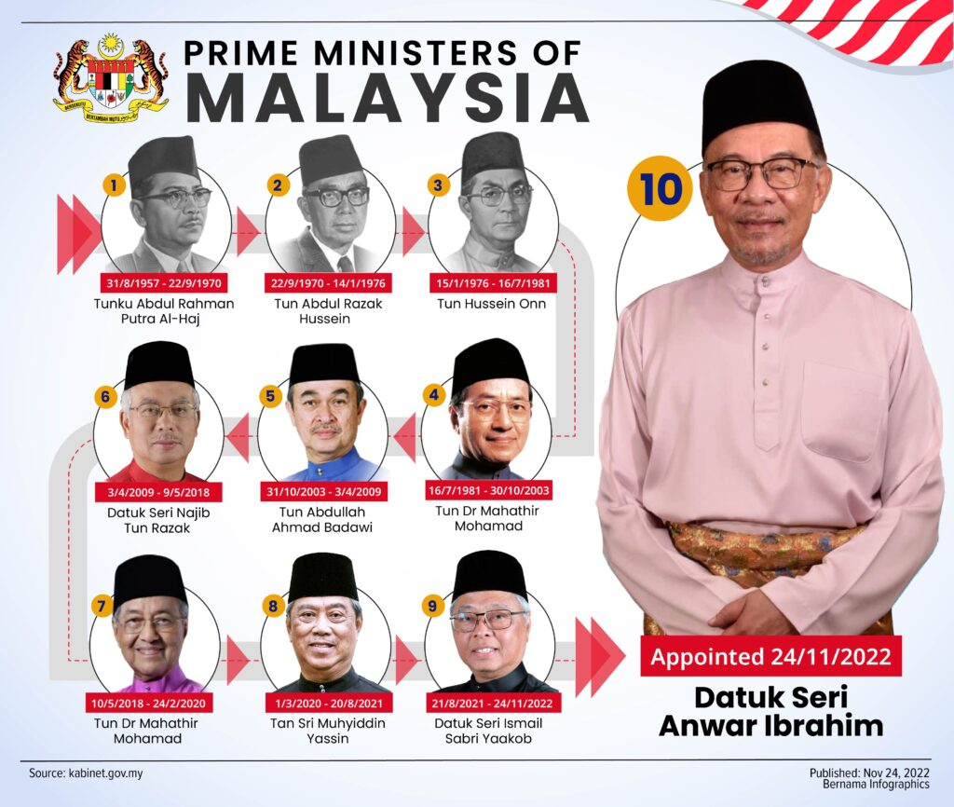

Slide 16
PRIME MINISTER
Head of Government
The appointment of a Prime Minister (PM) as the leader of the Cabinet is conducted by the YDPA.
A PM is appointed from the members of the House of Representatives (Dewan Rakyat) and receives the support of the majority of the Dewan Rakyat
THE POSITION OF PM
1. Head of Cabinet
Chairman of the Cabinet Meeting
Have a prerogative power to recommend a member of Cabinet
Control the agenda of the meetings
2. Party Leader
PM must be a leader of a winning political party or a coalition.
Currently – The Alliance of Hope (Pakatan Harapan, BN, GRS and others)

Slide 17
3. Chief Administrator
Naturally become the chief administrator
Must be able to relate to and motivate the bureaucracy to implement the government policies and program
4. First Diplomatic Officer
Representing the country
Strengthening the diplomatic ties with all the countries EXCEPT Israel
5. Statesman and Spokesperson for the Third World Country
This role popularized by fourth PM -Mahathir

Slide 18
SHADOW CABINET
REAL CABINET VS SHADOW CABINET
Important concept in Parliamentary Democracy.
A group of opposition Members of Parliament who assume the roles and duties of government ministers.
Historically, the Shadow Cabinet became a recognized entity within British politics.
The role of shadow cabinet to play a vital role as a viable alternative to the government in power
A) Real cabinet
Government in power (official)
Head: Prime Minister
Member: Members of Parliament
Duty: Executive responsibility
Clear portfolio
B) Shadow cabinet
Opposition party/alliances (unofficial)
Head: Leader of opposition
Appointed by the leader of opposition: commonly who win in the election
Check and balance coordination of portfolio with the government power

Slide 19
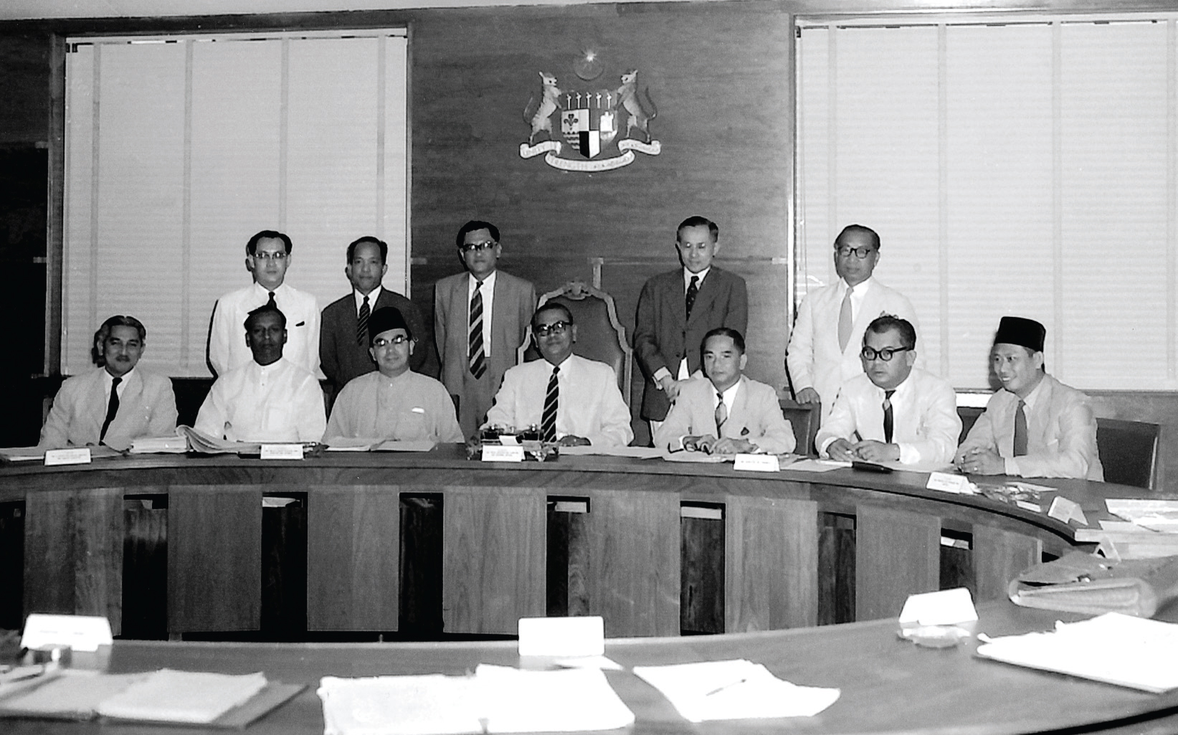
Tunku’s First Cabinet after Independence
Seated from left to right: Aziz Ishak, VT Sambanthan, Tun Abdul Razak Hussein, Tunku Abdul Rahman, HS Lee, Sulaiman Abdul Rahman, Sardon Jubir
Standing from left to right: Ong Yoke Lin, Abdul Rahman Talib, Khir Johari, Tan Siew Sin, Bahaman Shamsuddin

Slide 20
BUREAUCRACY/CIVIL SERVICE
Ministry and the subordinate government agencies = civil service
Assist the function of executive
Provide various services to the public
Implement the government policies and programs
Chief of the government civil service is the Chief Secretary (Ketua Setiausaha Negara - KSN).

Slide 21
Ministry
Ministry
Department
Public Services
Statutory Bodies
Non-Statutory Body
Highest government agency to plan/implement/control the government policy
Currently 30 ministries
Prime Minister Department Office - a federal government ministry in Malaysia
consists of the Prime Minister's Office, the Deputy Prime Minister's Office and more than 50 other government agencies
http://www.pmo.gov.my/home.php?menu=cabinet&page=1797

Slide 22
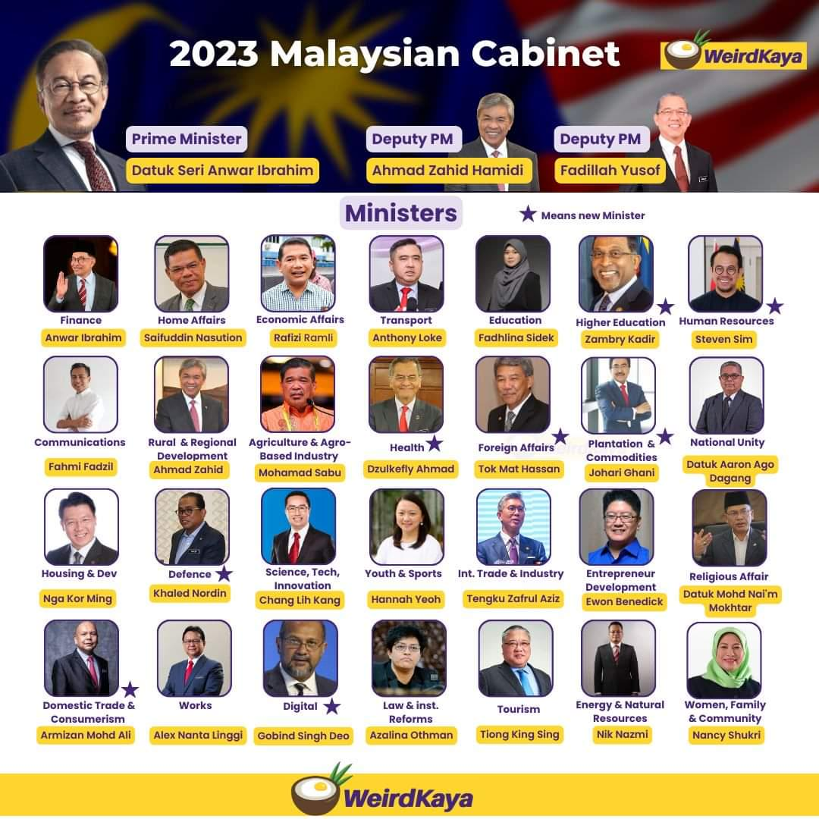

Slide 23
GOVERNMENT AGENCY
A government agency may be established by either federal government or a state government within a federal system.
The federal government agencies answer to the federal government. The state agencies usually answer to the state government.
Administrative units of government responsible for policy implementation and administration of governmental activities.
Responsible for implementing the things that government's responsible for towards the development and implementation of services to citizens.

Slide 24
Two types of government agency - Central Agency and Operational Agency.
Central agencies functions are to assist, coordinate and control the running of operating agencies. Examples: Malaysian Administrative Modernization And Management Planning Unit (MAMPU), National Institute of Public Administration Malaysia (INTAN), Implementation Coordination Unit (ICU), Economic Planning (EPU), Treasury ,Public Service Department (JPA).
Operational agencies functions is to execute and implement the policies decided upon by the government. Most government agencies in Malaysia consists of operational agencies - under ministry. Examples: Education Department (under Ministry of Education), Agriculture Department (under Ministry of Agriculture and Agro-Base Industry), Royal Malaysian Police and Malaysian Prison Department (under Ministry of Home Affairs)

Slide 25
COMMISSION
Free body to assist the executive function/Cabinet
2 types – permanent and ad-hoc commission (assist the Cabinet)
Examples of permanent commission – Election Commission, Malaysian Anti-Corruption Commission

Slide 26
STATUTORY BODIES
Two types
Established under Federal Act - Any body corporate, irrespective of the name by which it is known, that is incorporated pursuant to the provisions of federal law and is a public authority or an agency of the Government of Malaysia . e.g. Employee Provident Fund, Public universities like UPM, MARDI (Malaysian Agricultural Research and Development Institute)
Established or incorporated under the Companies Act 1965 – profit making. e.g PETRONAS, BERNAS (National Rice Company)

Slide 27
CONCLUSION
• Executive (Cabinet) in Malaysia is very important in the decision-making process and policy implementation
• Ministry and agencies support to the policy implementation process

Slide 28
REVISE….
• What is the function of executive?
• What is the function of Malaysia Cabinet?
• What is the meaning of collective decision of Cabinet’s member?
• What is the position of PM in Malaysia?
• How PM is appointed in Malaysia?
• What is the meaning of shadow Cabinet?
• Does Malaysia has a strong shadow cabinet?

Slide 29
Revise….
What is the function of the Cabinet?
Who is the first PM of Malaysia?
What is the name of the fifth and seventh PM of Malaysia?
What are the responsibilities of the PM?
List the governmental agencies responsible for implementing the public policy
What is the main role of a ministry?
Name the ministry which have a senior minister.
List 3 examples of ministries
What is the function of a commission?
Give two examples of statutory bodies.

